Slide 1

NICHE
Combination of an adapter aided with IoT and which can be controlled by an app as well.
Presented by;
Joel Siby
Jetin Dan
Jilson Jose
Daya Rachel
Niche

Slide 2
CONTENTS
Introduction
Motivation
Literature Review
Problem Statement
Objective
Proposed system
Block Diagram
Circuit Diagram
Working
Different components of Niche
Specifications
Designs
SWOT Analysis
Result and Conclusion
Niche

Slide 3
INTRODUCTION
Niche is a combination of an adapter controlled by a web app as well
as an android app.
The brain of the app is a firebase.
The remotely controlled socket using IoT methods work particularly well
with devices that have an ON/OFF switch which can be kept in ON position.
Niche is compatible with virtual assistants which can give you hands free
voice control.
It requires a wifi connection of 2.4GHz to work.
This can be used in outdoors for plug driven irrigation.
This will be more effective due to their ability to give users more control
over dumb devices.
Niche

Slide 4
MOTIVATION
The concept of digital India has been a key factor for our project.
In our day to day life, we all come across a busy schedule of works
therefore we doesn’t care about the electrical equipments.
Electricity bills may rise up, as well as sometimes it may cause fire.
As an electrical engineer it seems to be one of the important matters.
That is why we go for such a kind of home automation product.
Niche

Slide 5
LITERATURE REVIEW
In the paper, an intelligent energy control scheme, named the residence
energy control system (RECoS) has proposed, which is developed
based on wireless smart socket.
Internet of things technology helps to minimize energy consumption
of home appliances without deploying sensors.
The RECoS has 4 control modes, peak time control, energy time control,
energy limit control and user control. The former 2 operated for all
smart sockets, aiming to enhance the functionality of energy control.
The U.S patent No.4321593 issued to Ho illustrated a TV having the
build in view range monitoring device.
For most customers, there is no need for this function of TV screen.
However the parent requires this function for only a short period of time.
Therefore, they are not ready to buy a new TV screen.
The add on smart socket adapter solves this problem.
Niche

Slide 6
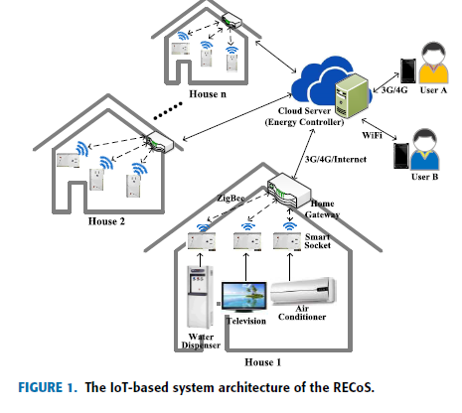
LITERATURE REVIEW (cont’ d….)
05/02/2021
Niche

Slide 7
PROBLEM STATEMENT
How can we control any ordinary appliance ?
Do we need to replace all the ordinary appliances with the smarter one?
A system that is easy for a layman?
Provide necessary safety?
Niche

Slide 8
OBJECTIVE
To make the power socket more user friendly and smart.
To develop a low cost power socket device.
To develop an IoT based power socket to control the device attached to it.
To increase the efficiency and to cope with the new technologies of IoT.
Application in agricultural sector to help farmers.
Niche

Slide 9
PROPOSED SYSTEM
In the present implementation, the product niche consists of an adapter,
a cloud server, a wireless terminal, a web app, and an android app.
Smart adapter is electrically connected to an alternating current (AC)
power supply and to the electrical appliances, to control the electricity
which is fed to the electrical appliances.
The wireless connection is achieved by a Nodemcu module which is an
ESP8266 based processor , this module helps to connect the adapter
to the cloud server.
To make a better user experience, a web app as well as an android app
is provided, the user can have a remote access to the adaptor and thus
the devices connected to it as well.
So the user need to press the button available on the app so as to turn the
adapter on /off.
Niche

Slide 10
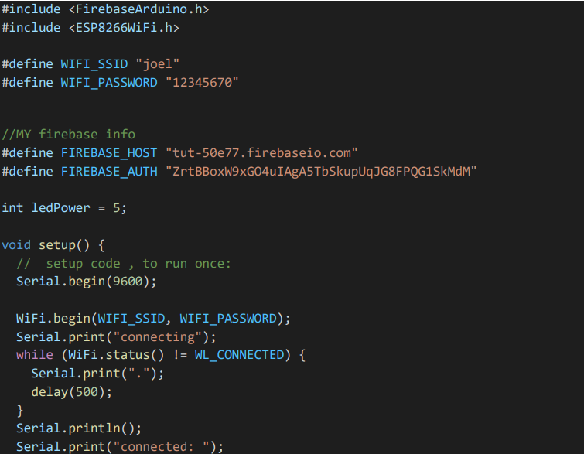
Programming the ESP8266 module
To connect the ESP8266 module to firebase
To connect the ESP8266 module to firebase

Slide 11
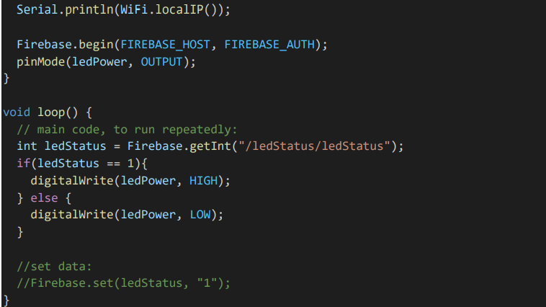
Name of the node module used in the firebase

Slide 12
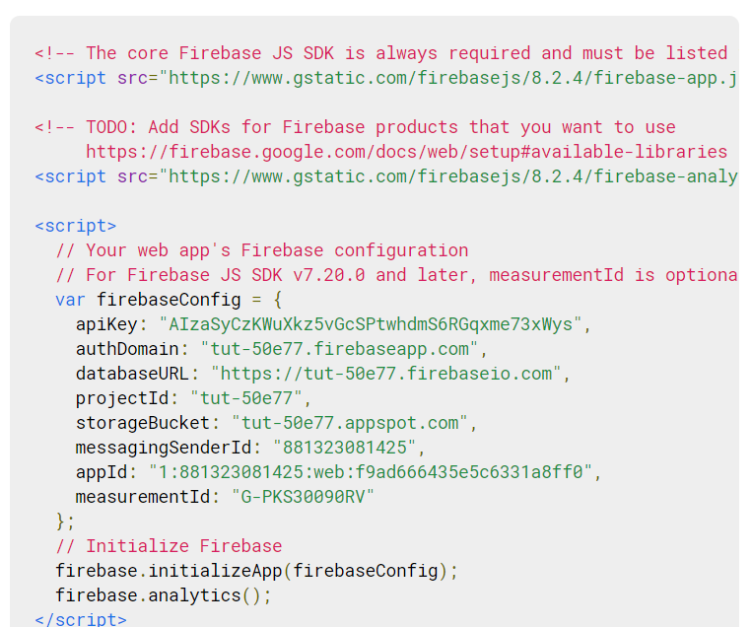
Firebase snippets for our webapp
We need to use these snippets in our javascript file so that our webapp can be connected with the esp8266module

Slide 13

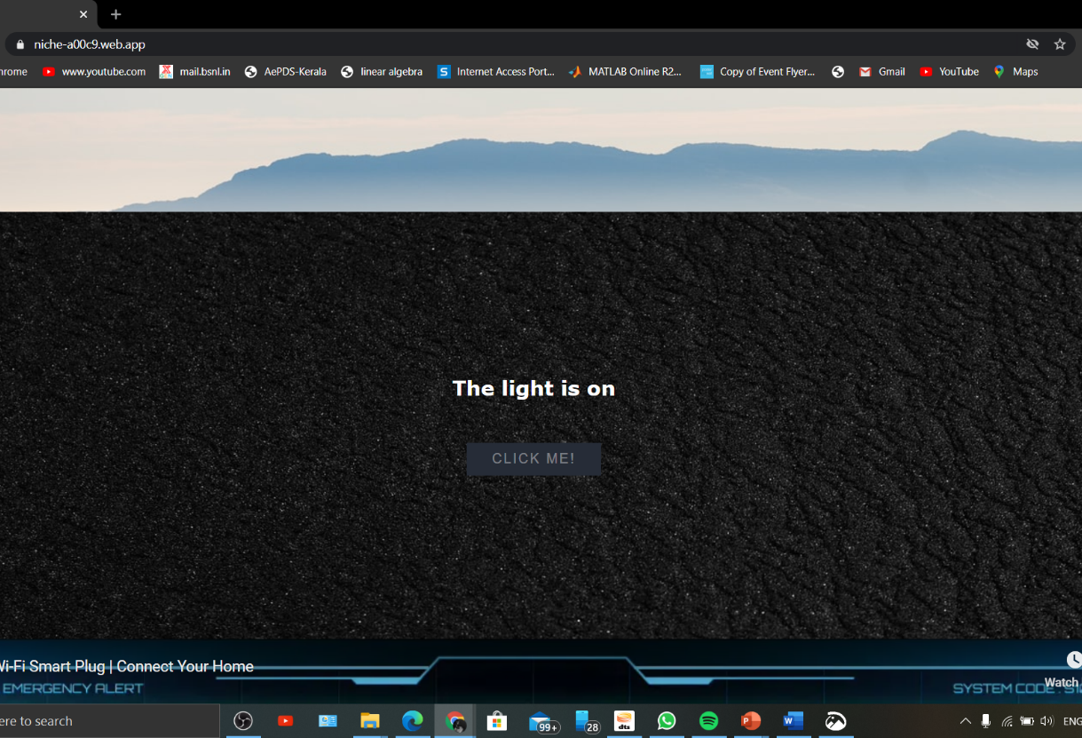
Web-app

Slide 14

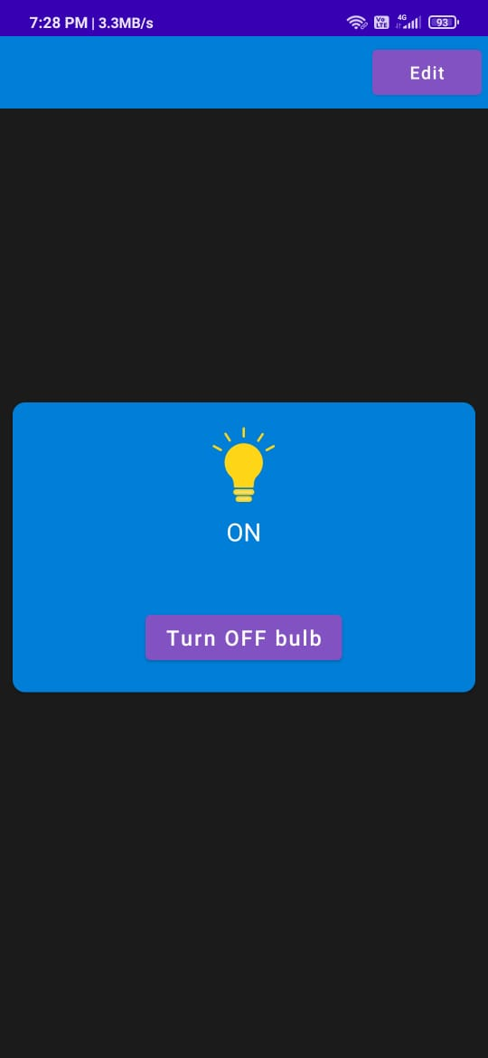
ANDROID APP

Slide 15
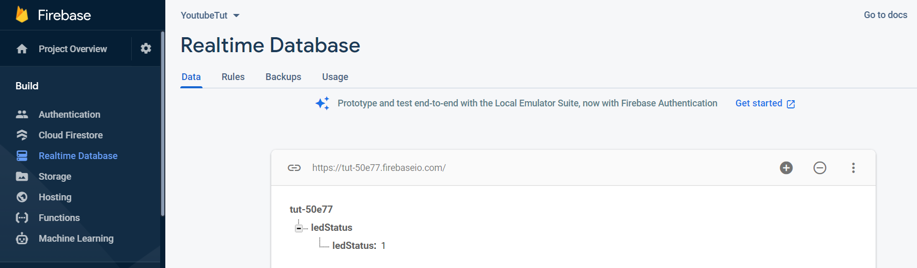

Slide 16
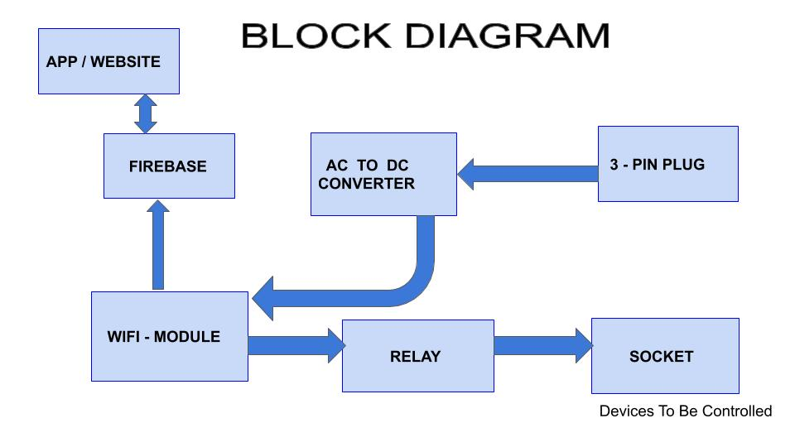
Fig 2: Block diagram
Niche

Slide 17
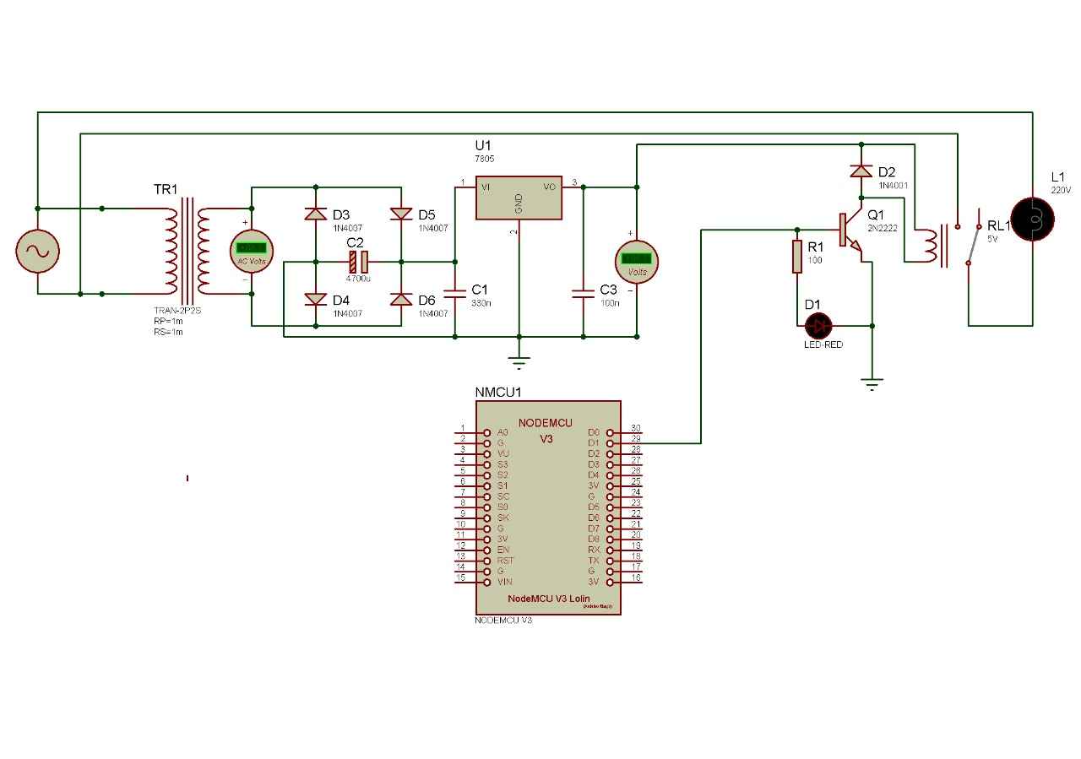
CIRCUIT DIAGRAM
Fig 3: Circuit Diagram
Niche

Slide 18
WORKING
Niche convert ordinary devices and appliances into smart ones.
This is done by allowing you to control the power supply to the appliance
through an app or a website.
The input signal from the supply is 220V AC supply.
But the operating voltage of Nodemcu is 5V DC.
Therefore, we use a 220V AC to 5V DC converter to convert and attain the
required output signal.
220 V AC supply is converted to 12V AC using a 220/12V step down
transformer. By rectification process 12V AC is converted to 12V DC.
Smoothening process is done to obtain pure DC power. Then the 12V DC
is converted into 5V DC using a buck converter IC.
The 5V supply is hence provided between the Vin and ground which helps to
turn on the GPSO pins of the Nodemcu.
Thus the Nodemcu attains power required to connect the wifi and firebase.
Now as the connection has been established, the user can control the
peripheral devices connected on any one of the GPSO pins using the app.
05/02/2021
Niche

Slide 19
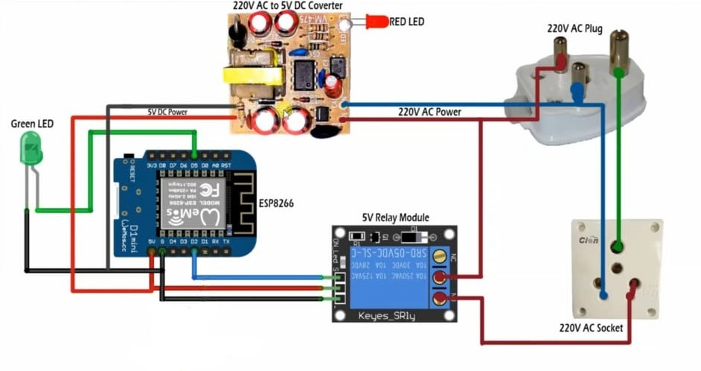
DIFFERENT COMPONENTS OF NICHE
Fig 4: Components of Niche
Niche

Slide 20
ESP8266 - 12E
ESP8266 – 12E is a Wifi module that works over 2.4 GHz Wifi spectrum.
This module can be programmed over Arduino IDE so that the connected
peripherals can be controlled over Wifi.
The layout of this board is based on a standard Arduino hardware design with
similar proportions to the Arduino UNO.
The development board also includes a USB to serial interface giving it the
ability to be connected and programmed directly from the Arduino Integrated
Environment (IDE) which is freely available for download from the
Arduino website.
Programming the ESP8266 – 12E via the IDE is then as straight forward as
programming any standard Arduino development board.
Many of the default Arduino commands will work including digital and
analogue pin functions. These examples range from simply blinking the
LED to turning the ESP8266 – 12E into a stand alone server.
Niche

Slide 21
RELAY MODULE
A power relay module is an electrical switch that is operated by an
electromagnet. The electromagnet is activated by a separate low power
signal from a microcontroller.
When activated, the electromagnet pulls either to open or close an electrical
circuit.
When an electrical circuit is passed through a coil, it generates a magnetic
field that in turn activates the armature.
The movement of the movable contacts makes or breaks a connection
with the fixed contact. When the relay is de-energized, the sets of contacts
that were closed, opens and breaks the connection.
This force is usually provided by a string, but gravity can also be used in
certain applications.
More power relays are manufactured to operate quickly.
Niche

Slide 22
ESP8266 – 12E works on 5V DC input, hence the 220V AC has
to be converted to 5V DC
1 STEP DOWN THE VOLTAGE LEVEL
The step down converters are used for converting the high voltage into low voltage. The converter with output voltage less than the input voltage is called as step down converter. 220V AC is converted to 12V AC using step down transformer.
CONVERTING AC TO DC
SMPS (Switched mode power supply) is an electronic power supply that
incorporates a switching regulator to convert electrical power efficiently,
SMPS transfers power from a DC or AC source to DC loads.
SMOOTHING THE RIPPLES WITH FILTER
12V DC can be regulated into 5V DC using a step down converter, but
before this it is required to obtain pure DC power. This pulsating DC can
be filtered using an inductor filter or a resistor-capacitor-coupled filter
for removing the ripples.
05/02/2021
Niche

Slide 23
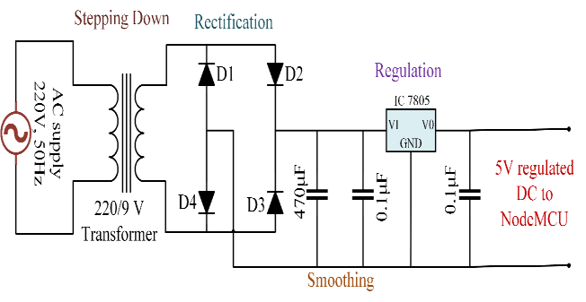
REGULATING 12V DC INTO 5V DC
12V DC voltage can be stepped down to 5V DC using a DC step
down converter called as voltage regulator.
All these 4 steps are done using 220V AC to 5V DC 2A circuit board
SMPS power supply AC DC converter module.
Fig 5: 220V AC to 5V DC converter
Niche

Slide 24
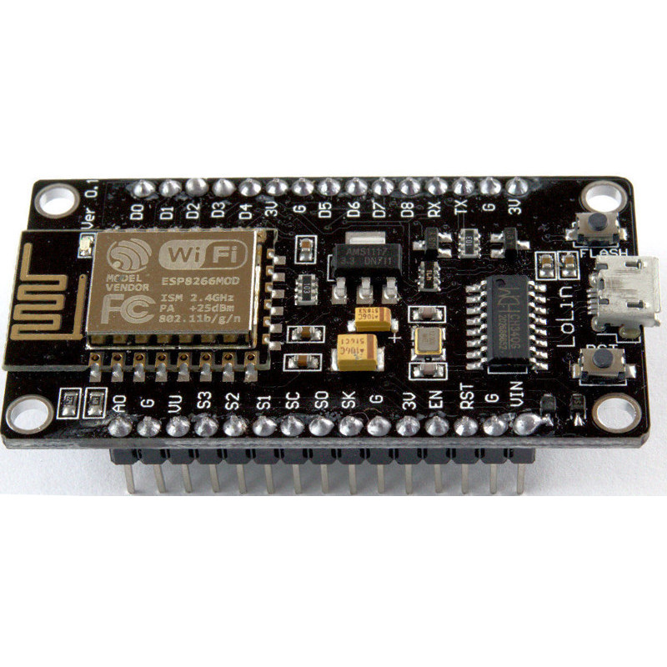
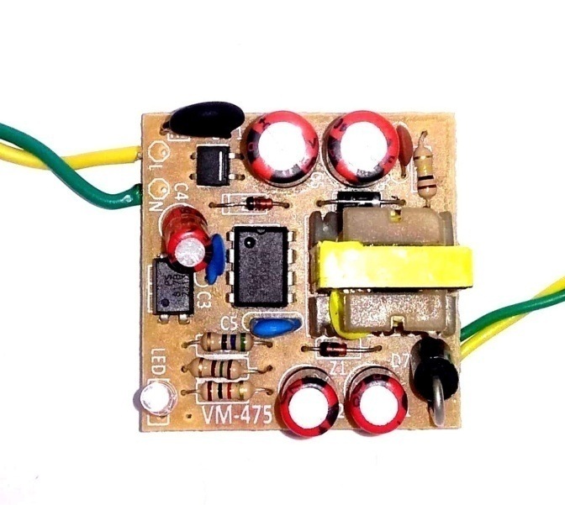
SPECIFICATIONS
 | 802.11b/g/n Integrated low power 32 bit MCU Operating temperature range: -40C- 125C Frequency range:2.4GHz- 2.5GHz Operating voltage : 3-5V Supports antenna diversity. Network protocol: IPv4, TCP/UDP/HTTP/FT Support WPA/WPA2 security
Converter | 220V to 5V 2A DC converter Tiny size 40*40*15mm thickness. High class component and PCB with short circuit protection. IC and opto coupler based voltage regulation. Best suitable for Nodemcu, bluetooth ,wifi, mobile chargers.
COMPONENTS
SPECIFICATIONS
Wifi module (ESP8266 -12E)

Slide 25
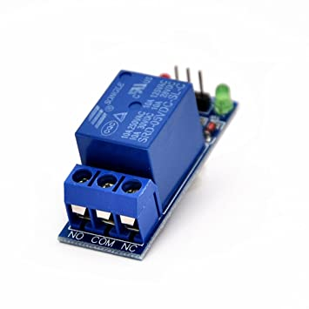
SPECIFICATIONS
 | Single Channel relay. Digital output controllable. Compatible with any 5V microcontroller such as Arduino. Rated current- through 10A (NO), 5A (NC) Control signal: TTL level Maximum switching voltage:250V AC/30V DC Maximum switching current: 10A Size: 43mm*17mm*17mm
COMPONENTS
SPECIFICATIONS
Relay module
3 Pin Socket
6A, 3 Pin Socket
3 Pin Plug
1 SQ MM*3C

Slide 26
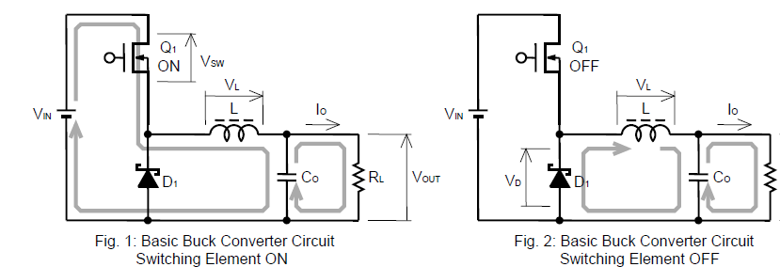
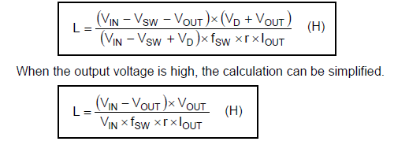
DESIGN OF BUCK CONVERTER
Design of inductor filter
Niche

Slide 27
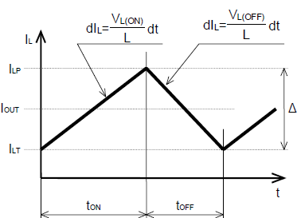
Vin = 12V Input voltage
Vout = 5V Output Voltage
Iout = 2A Output current
R = 0.3 Output Current ripple ratio
Vsw = 0.30 On state voltage drop of switching
element Q1
Vd = 0.26 Forward Voltage drop of free
wheeling diode
Fsw = 380kHz Switching frequency
(12- 0.30-5) * (0.26+ 5)
L =
= 12.9 micro Henry
(12-0.30+ 0.26) * 380000 *0.3* 2
When output voltage is high, L=
(12- 5)* 5
= 12.7 micro Henry
12* 380000*0.3*2
Niche

Slide 28
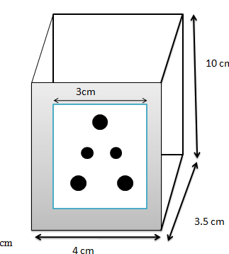
DESIGN OF OUTER CASING
The outer casing of
niche is made up of
plastic.
LENGTH OF OUTER CASING : 10 cm
BREADTH OF OUTER CASING: 4 cm
THICKNESS OF OUTER CASING: 3.5
Fig 6 : Dimensions of product
Niche

Slide 29
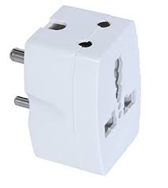
SAFETY DESIGN
OUTER CASING
Resistivity: 10¹⁰ ohm-cm to about 10¹⁹ ohm-cm
Dielectric strength: 10kV/mm ~ 30kV/mm
3. Electric shock protection class: IEC Class II
Operating temperature: 150° C ~ 300 ° C
Operating humidity: 40%- 50%
High durability.
Specific gravity = 1.35- 1.45
Tensile Strength: 34-62 MPa
ESP8266 - 12E
Security type: WEP/WPA-PSK/WPA2-PSK
Operating Voltage: 3.3 V
Standby power consumption of < 1.0mW
Operating temperature: -40 ° C ~ 125 ° C
Operating frequency: 2.4GHz-2.5GHz
Fig 7: Design of outer casing
Niche

Slide 30
ALGORITHM
Start
Import the firebase library.
Declare the variables for storing button status.
Setting username and password of WIFI.
Set database and auth key of firebase.
Setting up digital write and also begin WIFI connectivity.
Connections to the firebase is established using firebase.begin.
Setting up loop using digital write function, when the value is fetched from the firebase
If the value received is 1 device is turned on else it is turned off.
Continuing the loop.
05/02/2021
Niche

Slide 31
FLOW CHART
A
start
Setup digital & analog pin mode
Import firebase library
Receive/send signal from/to firebase
Declare the i/p variables
Declare firebase
If signal is received
Adapter is turned OFF
Adapter is turned ON
Setup username & password of wifi
0
1
Appliance is turned OFF
Appliance is turned ON
Setup database & auth key of firebase
A

Slide 32
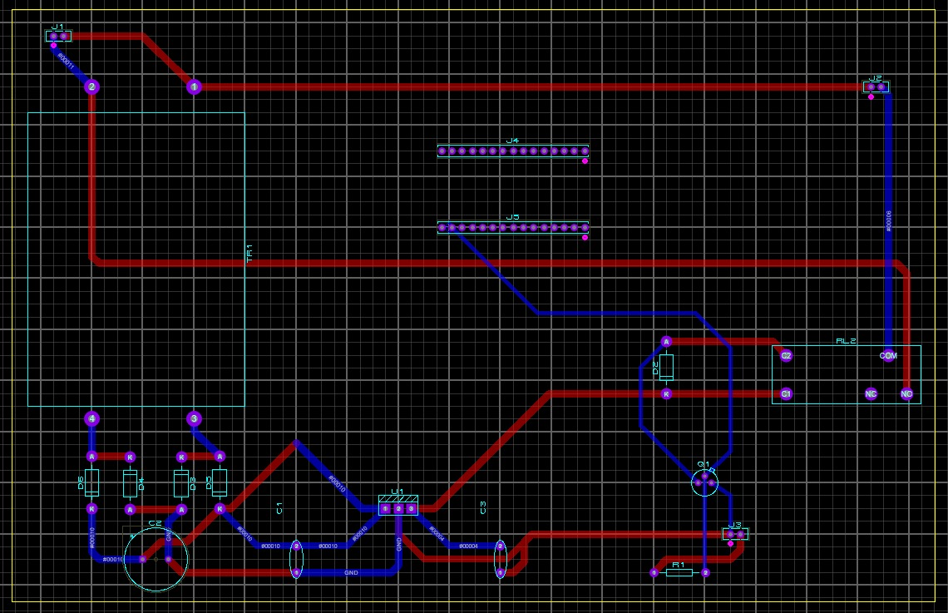
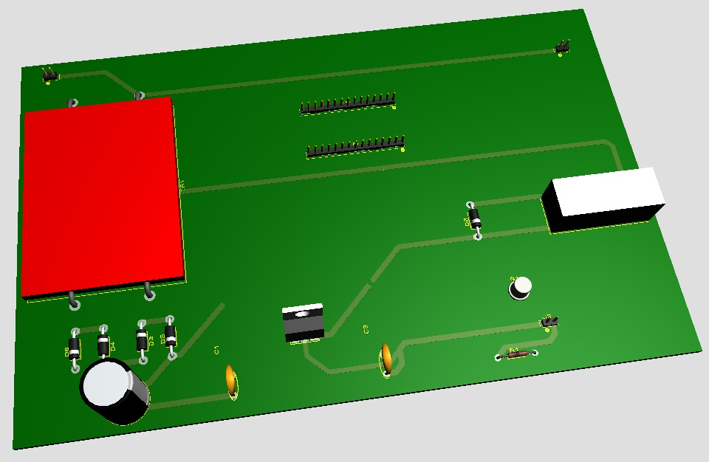
PCB LAYOUT

Slide 33
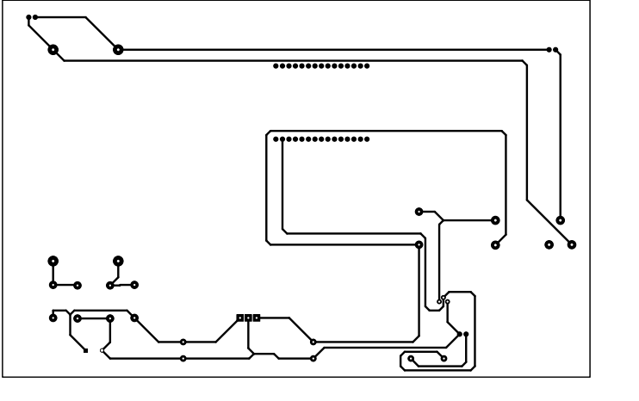
Fig 8: Illustrates Top Copper of PCB layout

Slide 34
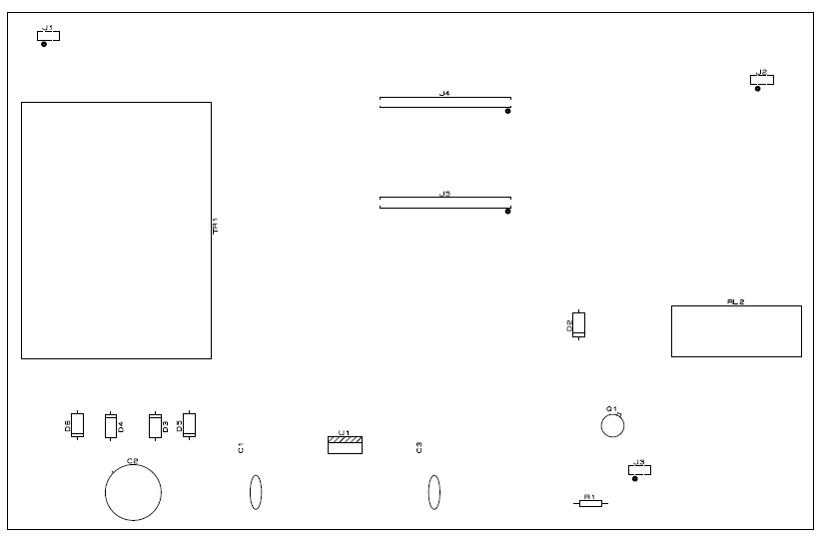
05/02/2021
Fig 18: Illustrates Bottom Copper of PCB layout

Slide 35
COST ANALYSIS
220V AC to 5V DC Converter
COMPONENTS
COST
ESP8266 – 12E
360/-
200/-
Relay Module
150/-
Jumper wire
200/-
Plug and socket
90/-
TOTAL COST
1000/-

Slide 36
SWOT ANALYSIS
STRENGTHS
1) It can be used and made available in even keypad phones since due to the improved technology of internet connections in keypad phones.
2) It helps us to access electronic devices even when we are far away from it.
WEAKNESSES
1) It can't be used in areas where no Internet connection are available like local areas, villages etc.
2) The life of the product depends on the life of ESP module.
OPPORTUNITIES
1) It will open up more sector to the world of home automation and development.
2) Conservation of energy.
THREATS
1) It can be accessed by anyone since no security credentials are provided into it.
2) Body is made of Plastic which is an e-waste and not ecofriendly.
Niche

Slide 37
RESULT AND DISCUSSION
The switch turns ON and OFF seamlessly when pressed for whatever purpose
irrespective of keypad or smart phone which can connect to Wifi. It doesn’t
depend on the location and can be accessed from anywhere.
It can be operated using Web app and Android app and has been tested several times.
The user will need to use the product as an assistant between the device and the
socket, however to control the product the user can access the app.
The working behind the hardwares is that IoT module and the app are connected
to the firebase which acts as a virtual switch.
So with the click of a button, we can make the device turned on or off thereby
controlling any device connected to it0.
NICHE helps us to improve and develop more and more sectors of home
automation through IoT.

Slide 38
CONCLUSION
We developed an efficient technology to cope with the expensive and old methods of technology of home automation by cheaper and more reliable IOT methods.
This could be further developed and used in much more developing home automation systems.
For More Information Do Check Our Website: https://niche-a00c9.web.app
And YouTube video
https://youtu.be/KYjP2tXheyc
ADVANTAGES
DISADVANTAGES
Energy efficient.
Hands free convenience
Enhanced security
Saves time with automated task
Environment friendly
Internet Reliance
Set up configuration
Power surges
In case of fault occuring
the device, it may be
difficult to recover for
those who are outside
India due to Security alert.

Slide 39
REFERENCES
[1] Taylor M, Feygin D, Nelson E, Peterson B, Ranganathan K, Byrd R, inventors; Becton Dickinson and Co, assignee. Smart adapter for infusion devices. United States patent US 10,398,852. 2019 Sep 3.
[2] Keles C, Karabiber A, Akcin M, Kaygusuz A, Alagoz BB, Gul O. A smart building power management concept: Smart socket applications with DC distribution. International Journal of Electrical Power & Energy Systems. 2015 Jan 1;64:679-88.
[3] Blanco-Novoa Ó, Fernández-Caramés TM, Fraga-Lamas P, Castedo L. An electricity price-aware open-source smart socket for the internet of energy. Sensors. 2017 Mar;17(3):643.
[4] Wang L, Peng D, Zhang T. Design of smart home system based on WiFi smart plug. Int. J. Smart Home. 2015 Jul;9(6):173-82.
[5] Tong YR, Li ZB. Design of intelligent socket based on WiFi. In2017 4th International Conference on Information Science and Control Engineering (ICISCE) 2017 Jul 21 (pp. 952-955). IEEE.

